Slide 1
Variational Shape Approximation
SIGGRAPH 2004
David Cohen-Steiner | Pierre Alliez | Mathieu Desbrun
Duke U. | INRIA | U. of So. Cal.

Slide 2
Outline
Introduction -
- Shape Approximation -
- Optimizing Shape Proxies -
- Results -

Slide 3

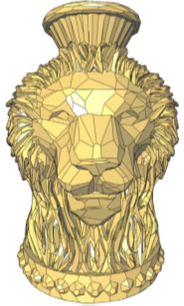
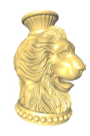
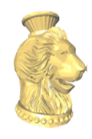
Introduction
A method concise, faithful approximation of complex 3D datasets is key to reducing the computational cost of graphics application.
Using the concept of geometric proxies.
400K-face
5K-face

Slide 4
Related Work
Partitioning
  Greedy
  Some of the metric used for clustering can be proven asymptotically optimal (i.e., for infinitesimal triangles) for the L2 metric.
  [Heckbert and Garland 1999. Optimal Triangulation and Quadric-Based Surface Simpliﬁcation]
Global optimization
  Energy Functional [Hoppe et al. 1993]
  ...
Notes:
Mesh decimation

Slide 5
Shape Approximation
Approximation Theory
  Functional Setting
  Height Field Approximation
  Arbitrary Geometry
Notes:
1. Approximation Theory Deal with the problem of replacing complicated mathematical objects with simpler ones while keeping the primal information content .
2. A lot of work has been done on best approximations of smooth functions – yet, less is known when it comes to approximating geometry.
http://zh.wikipedia.org/wiki/Lp%E7%A9%BA%E9%97%B4

Slide 6
Shape Approximation
Approximation Theory
  Functional Setting
    Strong results in Lp metric.
    Relies on parameterization
  Height Field Approximation
  Arbitrary Geometry
Notes:
1. Approximation Theory Deal with the problem of replacing complicated mathematical objects with simpler ones while keeping the primal information content .
2. A lot of work has been done on best approximations of smooth functions – yet, less is known when it comes to approximating geometry.
http://zh.wikipedia.org/wiki/Lp%E7%A9%BA%E9%97%B4

Slide 7
Shape Approximation
Approximation Theory
  Functional Setting
  Height Field Approximation
    Obvious Parameterization.
    Few results about optimality in Lp metric.
  Arbitrary Geometry
Notes:
1. Approximation Theory Deal with the problem of replacing complicated mathematical objects with simpler ones while keeping the primal information content .
2. A lot of work has been done on best approximations of smooth functions – yet, less is known when it comes to approximating geometry.
http://zh.wikipedia.org/wiki/Lp%E7%A9%BA%E9%97%B4

Slide 8
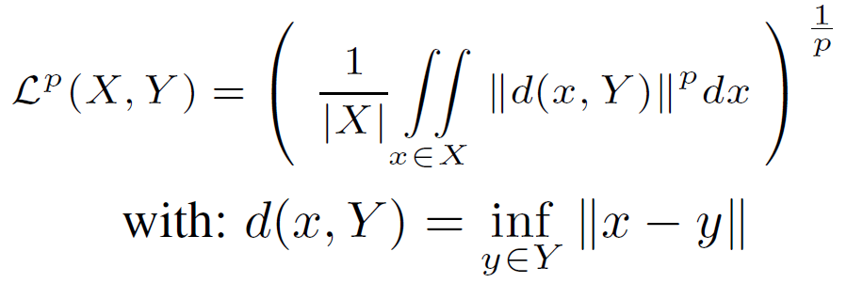
Shape Approximation
Approximation Theory
  Functional Setting
  Height Field Approximation
  Arbitrary Geometry
    Metric commonly used Lp.
Notes:
1. 貪婪演算法雖然可以降低三角形的面數，但會犧牲掉approximation error(, 或者可以保有approximation error criterion,但是不能控制三角形面數)
2. Metric commonly use: Lp distance between a surface X and an approximating surface Y is the extension of the traditional Lp metric for the functional setting.
X: surface X
Y: surface Y
||.||: Euclidean distance
|.|: the surface area

Slide 9
Shape Approximation
Propose to reformulate the problem of surface approximation by introducing the notions of shape proxies and variational partitions.
  Shape proxies:
    A mesh partition R = {Ri}
    A shape proxy is a pair Pi = ( Xi , Ni ); Xi = point, Ni = normal
  Variational partitions: iteratively seek a partition that minimize a given error.
Notes:
L2 metric:
Xi = Ri 區域的重心
Ni = Ri 特徵向量的最小特徵值來做協方差矩陣
L2,1 metric:
Xi = Ri 區域的重心
Ni = Ri 三角形的法向量面積加權平均

Slide 10

Shape Approximation
Metrics of Proxies
  L2 metric
Notes:
利用L2(歐基里得)距離套用到這篇paper所提出的框架
移除平方根和面積正規化
圖: L2 形狀最加化最佳化 partition (左) 基於點的協方差矩陣會嚴重破壞partition →所以導致分個成多個小塊，(右)基於三角形的協方差矩陣提供預期的多邊形逼近，捕捉真實幾何→分割的較完整

Slide 11

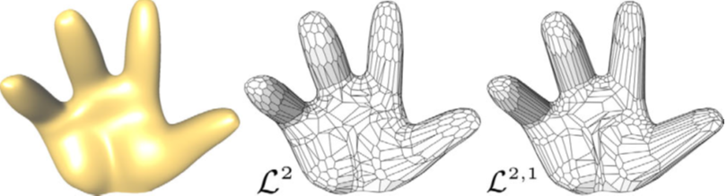
Shape Approximation
Metrics of Proxies
  L2,1 metric

Slide 12
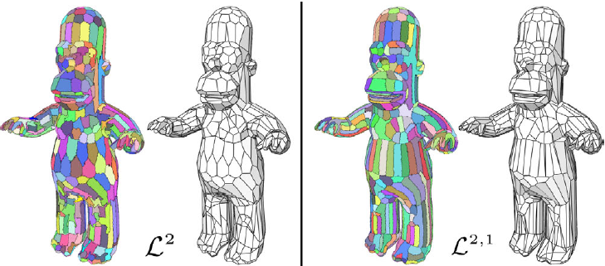
Shape Approximation
Metrics of Proxies

Slide 13
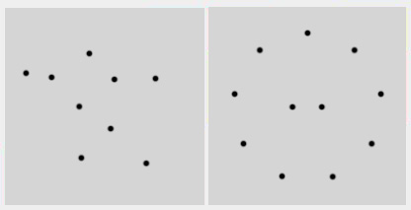
Optimizing Shape Proxies
Background on Lloyd’s Clustering Algorithm.
  Voronoi Diagram + finds the centroid of each set in the partition
Lloyd’s method hinges on the two phases
Notes:
http://www.csie.ntnu.edu.tw/~u91029/VoronoiDiagram.html

Slide 14
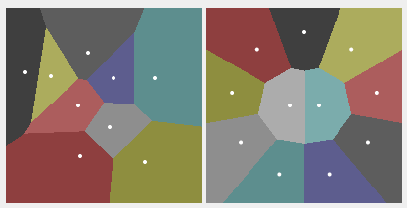
Optimizing Shape Proxies
Background on Lloyd’s Clustering Algorithm.
  Voronoi Diagram + finds the centroid of each set in the partition
Lloyd’s method hinges on the two phases

Slide 15
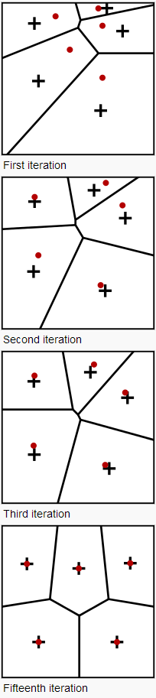
Optimizing Shape Proxies
Background on Lloyd’s Clustering Algorithm.
  Voronoi Diagram + finds the centroid of each set in the partition
Lloyd’s method hinges on the two phases
(1)
(2)
(3)
(4)
Notes:
http://en.wikipedia.org/wiki/Lloyd's_algorithm

Slide 16
Optimizing Shape Proxies
Background on Lloyd’s Clustering Algorithm.
Lloyd’s method hinges on the two phases:
  Geometry Partitioning
      It is used an error-minimizing region-growing algorithm. The object is segmented in non-overlapping regions.
  Proxy Fitting
      For each partition it is computed an optimal local representative.

Slide 17
Results
300 proxies, 346 triangles
50 proxies, 100 triangles

Slide 18
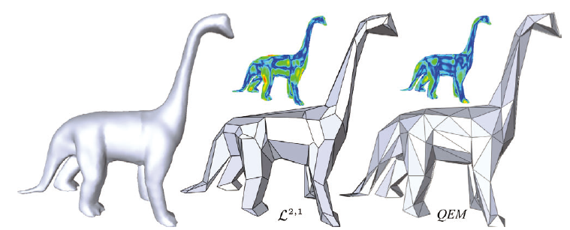
Results

Slide 19
Results
700K triangles
5 min
10 min

Slide 20
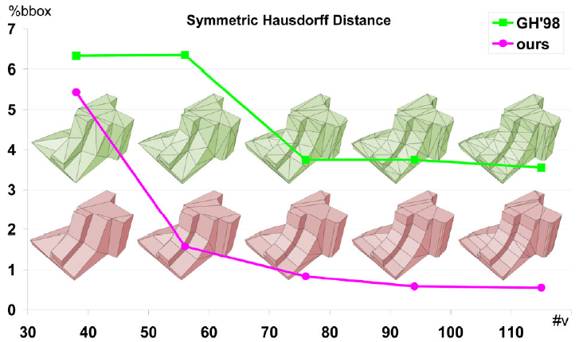
Result
Notes:
Comparison of the Hausdorff error for QEM [Garland and Heckbert 1998] and for our L2;1 technique, for equal number of vertices (a comparison using equal number of edges leads to an extremely similar curve).
當點取的越多時，相對的面的數量比數變化會較大，但月後面比數會變一定比例。

